Slide 1
Digital Dash
By Adam Deokaran and Tyler Chatarpal of
NamesAreHardToMake Productions

Slide 2

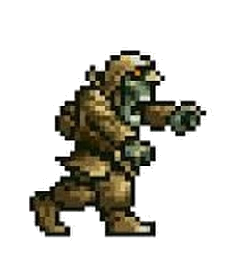


About our Game
Running game.
In this game our goal is to get far and survive.
During this task we are running from zombies while facing the obstacles in front of the player in the game.
There are random power-ups scattered across the map to aid the player in their quest to reach the end.

Slide 3
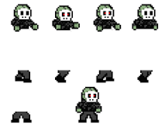
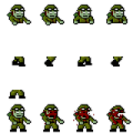

Game Description

Slide 4
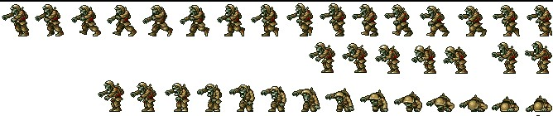

Slide 5




